Slide 1
Heat
Phase Changes
LabRat Scientific
© 2018

Slide 2
Phase Change
A phase change is when matter changes from one physical state to another. A physical state can be “solid”, “liquid”, or “gas”.
This diagram shows how the temperature changes when water is cooled and changes state from a gas to a liquid, and then to a solid.

Slide 3
Terms
The following phase changes usually involve particles moving farther apart:
Melting (a.k.a. Fusion) - When a solid becomes a liquid
Vaporization - When a liquid becomes a gas
Sublimation - When a solid becomes a gas (skipping the Vaporization Phase)
The following phase changes usually involve particles moving closer together:
Condensation - When a gas becomes a liquid
Freezing - When a liquid becomes a solid
Deposition - When a gas becomes a solid (skipping the Freezing Phase)

Slide 4
Heat Involved with Phase Change
When a substance is heated the particles become more energetic, usually move farther apart, and become more chaotic.
When a substance is cooled the particles become less energetic, usually move closer together, and become more orderly.
When melting or vaporization occurs energy is absorbed by the substance.
When condensation or freezing occurs energy is released by the substance.

Slide 5
Let’s look at how water moves through its various changes in state.

Slide 6
Gaseous State
When in the gaseous state, the molecules zoom around in a chaotic manner and bounce off one another and the walls of the container. In this state, the average Kinetic Energy of the molecules is sufficient to overcome the Potential Energy of attraction.

Slide 7
Condensation - Gas to Liquid
When heat is pulled away from a liquid (such as when water is placed in the freezer) the average temperature of the water decreases.
As the average temperature drops, some of the molecules will have a temperature below the average. At some point some of the molecules will lose enough kinetic energy and will stop bouncing around the container. They will fall to the bottom of the container and begin to condense with other cooler molecules.

Slide 8
Liquid State
As the average temperature of the water continues to decrease, more and more molecules will stop bouncing around the container. Eventually they will all condense to the bottom, but the will still have some kinetic energy and thus they will not be well organized.

Slide 9
Freezing – Liquid to Solid
During freezing more kinetic energy is lost and the molecules begin to organize themselves into crystals. This is depicted by the orderly stack of molecules on the left and right side of the diagram.
This crystallization will generally happen towards outer fringes of the volume first. The water will then solidify moving towards the center of the water mass.
Note: The molecules will always have some kinetic energy, at least until they are taken down to absolute zero.

Slide 10
Frozen
When all of the molecules crystalize into one highly organized mass the water is completely frozen. During the freezing process the temperature of the water remained at 0 ⁰C, but once the water is completely frozen its temperature can then drop to the temperature of its surroundings.

Slide 11
Let’s look at to simple experiments to see if we can observe what happens to the temperature of the water when it changes state.

Slide 12
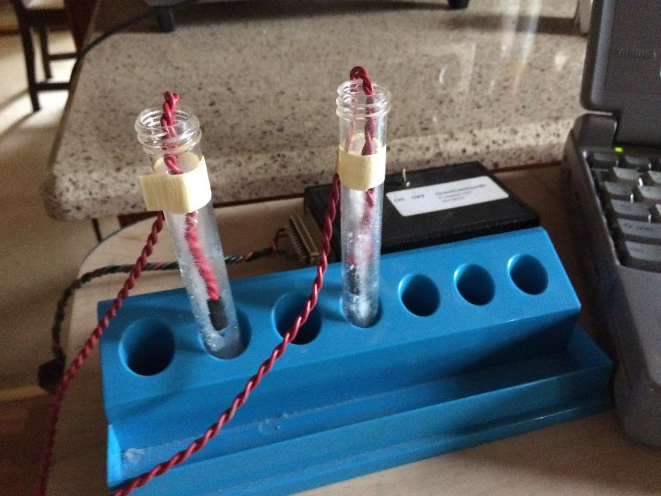
Freezing Experiment
A simple experiment can be conducted to look at the temperature change as a liquid (water) is cooled and becomes a solid (fusion).
Process:
Thermistors that are connected to a data acquisition system are placed in test tubes of water
The test tubes are placed in the freezer
Data is collected while the water cools and then freezes.

Slide 13
Water is cooling down
Ice is melting

Slide 14
Freezing - Observations
The temperature of the water decreases until it reaches 32 ⁰F (0 ⁰C). During this time the water is still liquid.
Once the temperature of the water reaches 32 ⁰F the temperature stops changing and stays constant. During this period the water started to be come a solid along the walls of the test tube.
Once water became completely solid, the temperature dropped once again, ultimately reaching the temperature of the air inside the freezer.
When the test tube was removed from the freezer, the temperature of the ice rose to 32 ⁰F and then remained constant for a period of time.
The temperature of the water rose once the ice had melted, ultimately climbing up to the air temperature in the room.

Slide 15
Freezing - Conclusions
The temperature of the water does indeed remain constant while the water changes from liquid to solid.
Once the water is completely solid, its temperature is free to drop to the temperature of its surroundings.

Slide 16
Why does the temperature stay constant during freezing?
When water freezes (liquid-to-solid phase change) the liquid will start to release energy in the form of heat. This occurs due to the bond-forming phenomena when the water molecules become more organized and crystalize. This heat replaces the heat being drawn way by the cold surroundings of the freezer.
An interesting thing happens when water freezes. Generally, when an object is cooled, it contracts and becomes more dense (same mass in slightly smaller volume). However, when water freezes it actually expands and become less dense. This is why ice floats and the surface of a pond freezes and not the bottom…

Slide 17
Calculating the heat (q) that must be removed from a test tube of water to make it freeze and then reach the freezer temp
Required Information -
Amount of Water: 10 g
Total Change in Temperature: 18 C (room temp) to -11 C (freezer temp)
Molar heat capacity of liquid water (C): 75.4 J/mol * ⁰C
Molar heat capacity of solid water (C): 37.6 J/mol * ⁰C
Heat of Fusion for Water (∆H⁰_{fus}) : 6.02 kJ/mol
Governing Equations -
q = n * C * ∆T (when material is not undergoing a phase change)
q = n * (- ∆H⁰_{fus}) (when material is undergoing a phase change)

Slide 18
First we need to calculate the number of moles of water in the test tube:
1 mole of water has a mass of 18.02 g
There were 10 g of water in the test tube
Moles of water = 10 g (1 mole / 18.02 g) = 0.56 mole
We then need to make calculations for each stage the liquid passes through:
Stage 1 – Cooling water from room temperature to freezing point
Stage 2 – Freeing the water
Stage 3 – Cooling the solid water to the freezer temperature
According to Hess’s Law, the total heat released is the sum of the heat losses from each stage.

Slide 19
Stage 1 – Cooling the water from room temperature to the freezing point
q = n * C * ∆T
= 0.56 mole * 75.4 J/(mole*⁰C) * ( 0 ⁰C - 18 ⁰C )
= - 760 J = - 0.76 kJ
Stage 2 – Freezing the water
q = n * (- ∆H⁰_{fus})
= 0.56 mole * (- 6.02 kJ/mole)
= - 3.4 kJ
Stage 3 – Cooling the solid water to the temperature of the freezer
q = n * C * ∆T
= 0.56 mole * 37.6 J/(mole*⁰C) * ( - 11 ⁰C - 0 ⁰C )
= - 231 J = - 0.23 kJ

Slide 20
From Hess’ Law:
Total Heat Loss = - 0.76 kJ + ( - 3.4 kJ ) + ( - 0.23 kJ )
= - 4.39 kJ
Since the governing equations are dependent on the number of moles (a.k.a. mass) of the water, larger amounts of water will result in a higher heat loss.
Recall that heat and temperature are not the same thing. The experiment could be conducted with a cup of water, and while the same delta-temperatures would exit, the total heat loss would be much different.

Slide 21
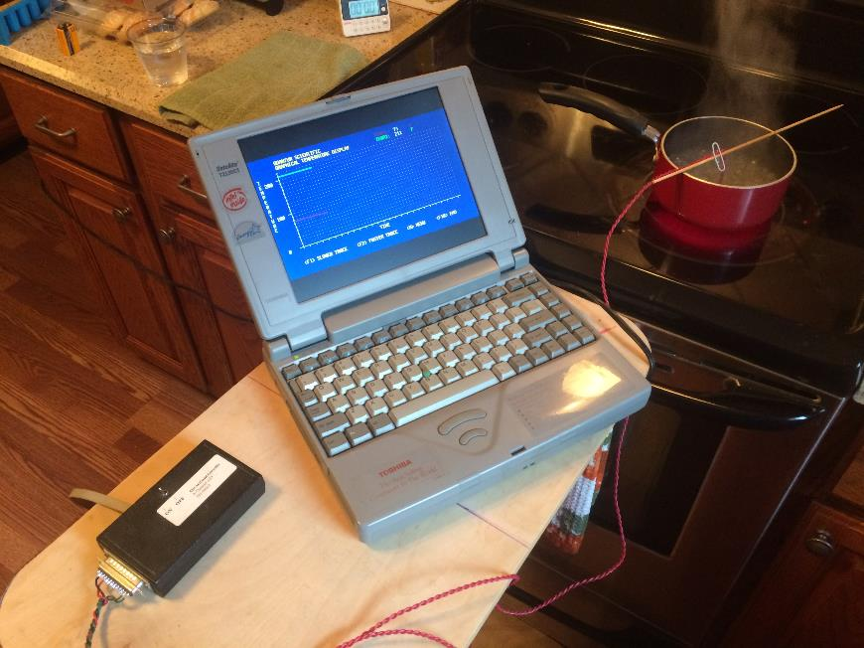
Vaporization (Boiling) Experiment
Another simple experiment can be conducted to look at the temperature change as a liquid (water) is heated to its boiling point (a.k.a. the point where the liquid water changes to a gas (vapor)).
Process:
A thermistor that is connected to a data acquisition system is placed in a pan of water.
Stove burner is turned on
Data is collected while the water heats up and then boils.

Slide 22
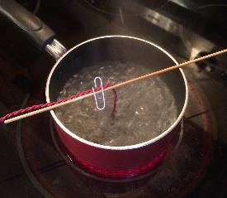
Heating stopped, water stops boiling and begins to cool
Water is being heated
Water Begins to Boil

Slide 23
Vaporization - Observations
The temperature of the water began to climb when the pot was placed on the hot stove burner.
Bubbles formed on the bottom of the pan prior to the water reaching the boiling temperature (212 ⁰F)
Once the water began to boil violently the temperature was at 212 ⁰F where it remained throughout the remainder of the experiment.
The temperature of the water began to drop below the boiling point once the stove burner was turned off.

Slide 24
Vaporization - Conclusion
The temperature of the water does indeed remain constant while the water changes from a liquid to a gas.

Slide 25
Why does the temperature stay constant during boiling?
When vaporization occurs (liquid-to-gas phase change) the liquid will start to absorb the heat. The heat added to the system during this phase change goes into overcoming the intermolecular forces and increasing the average distance between particles rather than increasing the temperature of the liquid.
The temperature of the water is actually the “average” temperature of all the molecules. Some molecules will have a slightly higher temperature while others will have a slightly lower temperature. At the boiling point, molecules at a slightly higher temperature will have sufficient Kinetic Energy to escape the surface of the liquid (the vapor or “steam” you see leaving the pot). As this happens, a small portion of the heat leaves with it. As more heat is added to the boiling water, more molecules escape – each carrying with it some heat…

Slide 26
What happens if we allow vaporization to occur in a sealed container?
Water molecules will continue to liberate themselves from the surface of the liquid when heat is applied. As more molecules vaporize, the vapor above the liquid will be come more dense and the pressure will rise.
As the pressure rises, its harder for the molecules to liberate themselves from the liquid, and the increased number of molecules in the vapor increases the number of molecules that bounce back into the liquid.

Slide 27
What happens if we allow vaporization to occur in the sealed container?
If we hold the temperature at a constant, eventually the number of molecules leaving the surface of the liquid will be balanced by the number of molecules reentering the liquid. When this happens, the pressure will reach equilibrium..
This equilibrium is known as the vapor pressure. If the temperature is increased the vapor pressure will increase.
A device known as a pressure cooker relies on this physics. The water is boiled in a semi-sealed vessel. The increased vapor pressure makes it harder for the molecules to be liberated from the liquid surface. This allows the heat to increase the liquid temperature above the “normal” boiling temperature rather than using it to break the bonds.

Slide 28
Sublimation and Deposition
Sublimation:
When a solid sublimates it becomes a gas without passing through the liquid phase. This can occur in very cold and dry environments as well as in a household freezer. This can be seen by placing a single ice cube on the freezer rack, where over time, the ice cube will shrink without leaving an icy pool at the bottom of the freezer.
Deposition:
When a gas (i.e. water vapor) under goes deposition it becomes a solid without passing through the liquid phase. This is how snow forms in clouds and how frost is created.

Slide 29
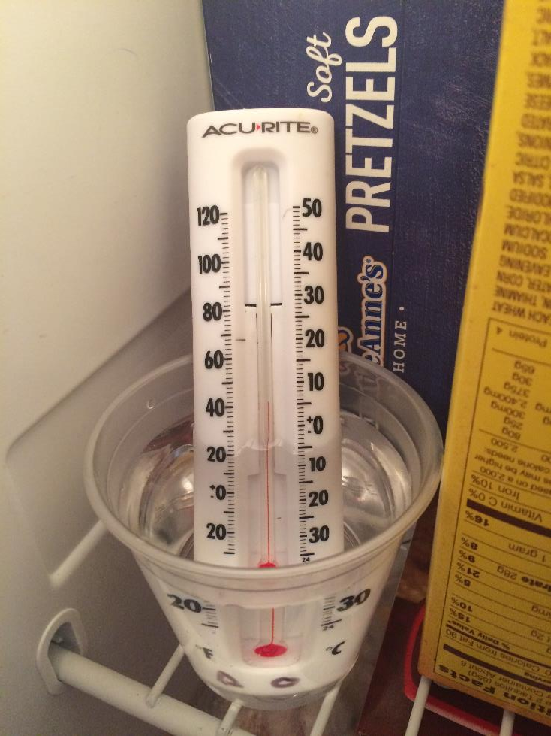
Alternate Experiment Set-up
These experiments can be recreated using a simple thermometer. A few words of wisdom:
Continuous opening of the freezer door to make measurements will draw out the freezing process because the freezer wont stay as cold
Be very careful when conducting the boiling test because the hot water can scald and cause injury.

Slide 30
Questions ?

